Slide 1

Internal Validity
Anh Nguyen, Hanna Song

Slide 2
Revised Research Question
and Hypothesis
Research question:
Does COVID affect post trends from mental illness related subreddits?
Hypothesis:
Mental health-related subreddits exhibit a shift in post trends as well as the number of engagements based on post texts, number of comments and upvote ratios between periods pre-covid and post-covid
Notes:
Does covid affect post trends from mental illness related subreddits?
Mental health-related subreddits exhibit a shift in post trends as well as the number of engagements based on post texts, number of comments and upvote ratios, between periods pre-covid, mid-covid, and post-covid

Slide 3
Description of Pilot Data
Our dataset have two time intervals:
Pre-COVID: 2018 - 2020
Post-COVID: 2020 (Feb 11th by WHO) - 2022
These are 9 mental illness-related subreddit we have collected – top posts
Depression, anxiety, adhd, bipolar, ptsd, Schizophrenia, Eating Disorders, Brain Fog, SuicideWatch
Notes:
Schizophrenia

Slide 4
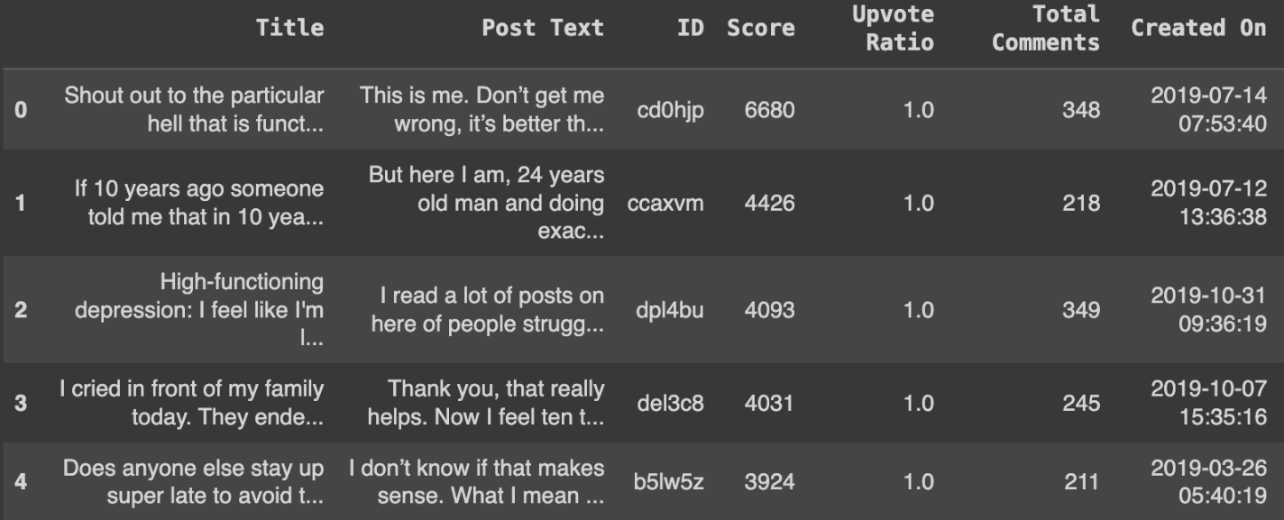
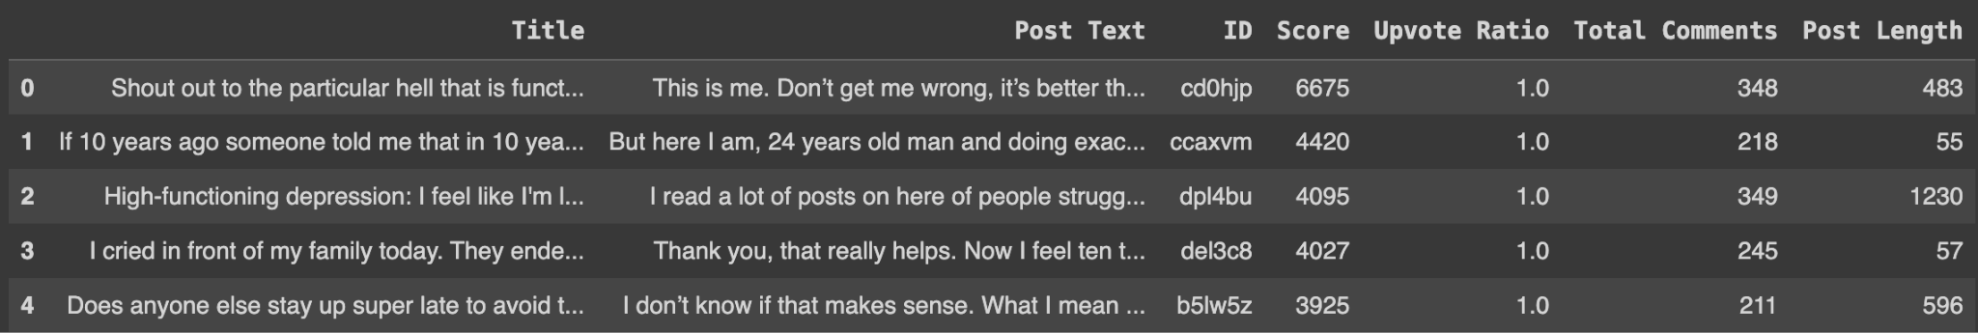
Description of Pilot Data
Each dataset contains:
Title
Post Text
ID (User ID)
Score
Upvote Ratio
Total Comments
Created On
Added: Post Length
Post content : Topic modeling, post length
Engagement: number of comments and upvote ratio
→ using top posts which is already on trend
Sample Dataset from Depression Subreddit
Notes:
Schizophrenia

Slide 5
Causal Theory
COVID pandemic has brought about various stressors and uncertainties, such as health concerns, economic instability, social isolation, and disruptions to daily routines
→ increased levels of anxiety, fear, and emotional distress among individuals
Subreddit communities serve as safe spaces for individuals to express their thoughts, emotions, and concerns related to mental health.
Notes:
The pandemic has introduced various stressors and uncertainties, such as health concerns, economic instability, social isolation, and disruptions to daily routines. These stressors can contribute to increased levels of anxiety, fear, and emotional distress among individuals.
Subreddits dedicated to mental health-related topics provide online platforms for individuals to seek information, share experiences, and seek support from others facing similar challenges. These communities often serve as safe spaces for individuals to express their thoughts, emotions, and concerns related to mental health.

Slide 6
Proposed Cause and Effects
Cause | Effect
COVID-19 | Shift in post trends Increased number of post engagements (comments and upvotes)
Shift in post trends | Topics such as fear of infection, social isolation, grief, coping strategies, and pandemic-related stressors may become more prevalent in posts on mental health-related subreddits
Increased number of post engagements | As the pandemic caused disruptions to daily routines, individuals may have more time and inclination to engage in online activities, including posting, commenting and upvoting in mental health-related subreddits

Slide 7
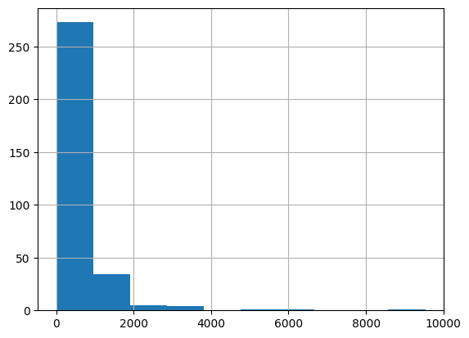
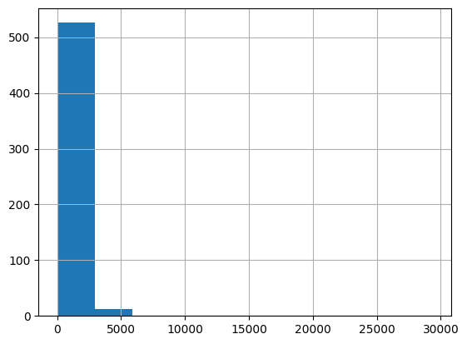
Statistical Relationships in
Pilot Data
Histogram of Post length Pre-COVID in depression subreddit
Histogram of Post length Post-COVID in depression subreddit
Notes:
need to explain why no num of posts — limited to 1000 posts to scrap so we decide to use top posts which is already on trending

Slide 8
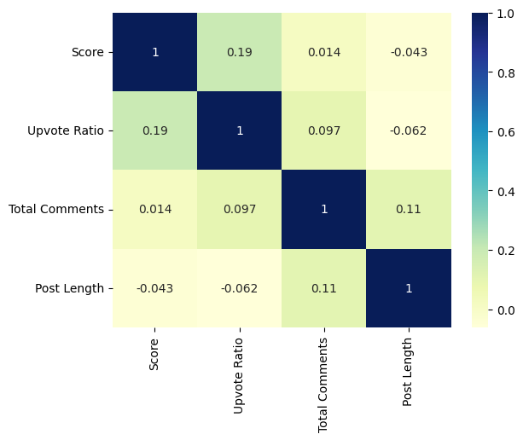
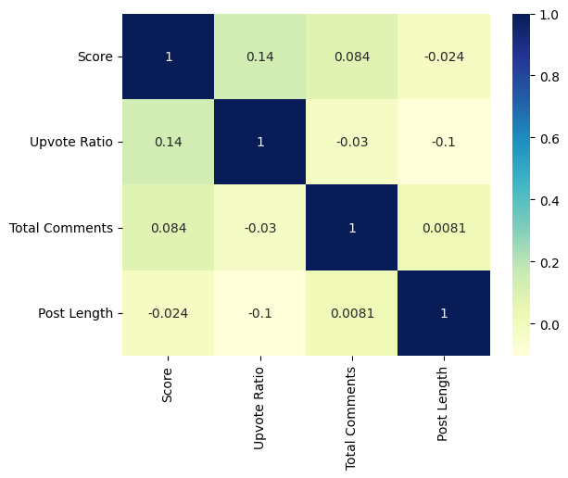
Statistical Relationships in
Pilot Data
Correlation of Continuous Variables Pre-COVID in depression subreddit
Correlation of Continuous Variables Post-COVID in depression subreddit
Notes:
need to explain why no num of posts — limited to 1000 posts to scrap so we decide to use top posts which is already on trending

Slide 9
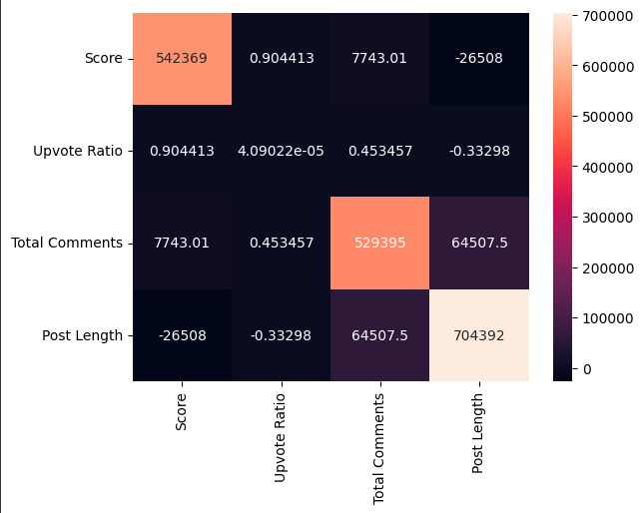
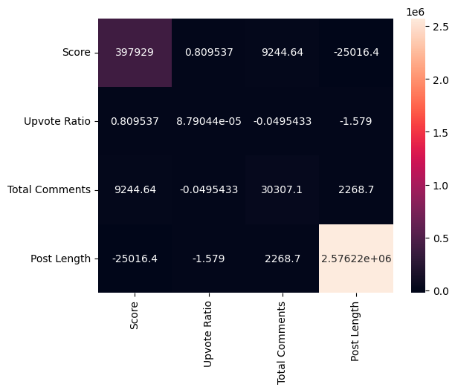
Statistical Relationships in
Pilot Data
Temporal Precedence:
COVID precede the change in post trends: Earliest post is from 2018, newest post is from 2022
There is an increase in post length and number of post interactions (upvote ratios and comments)
Covariance of Cause and Effect: shift of post trends linked to COVID
Pre-COVID Post-COVID

Slide 10
Threats to Internal Validity
Threats to Internal Validity | Susceptible or not
History Confound Personal situations, historical events, societal changes, or policy shifts that occur concurrently with COVID | Susceptible Unless there are efforts to control other major events that can impact mental health trends
Instrumentation Confound Reddit top posts algorithm changed over time | Susceptible Collecting with Reddit API for using same algorithm for two time intervals

Slide 11
Threats to internal validity
Threats to Internal Validity | Susceptible or not
Maturation Involves users’ natural change in behavior and maturity over time not due to COVID | Susceptible Mental health can be influenced by various factors; cannot be controlled
Experimental Mortality People with mental disorders might stop posting on social media | No Since we only look at data from 2018 - 2022, we won’t be affected by experimental mortality
Statistical regression Selection bias: People with severe depression might post more | Susceptible Impact the generalization of findings

Slide 12
Plausible Threats
Susceptible Threat | Plausible
History Confound | Yes, as there can be other historical events, personal situations and outside factors that could potentially influence mental health-related subreddits
Instrumentation Confound | Yes, changes in measurement tools or methods used to analyze trends could introduce biases or inconsistencies

Slide 13
Plausible Threats
Susceptible Threat | Plausible
Maturation | Yes, since individuals’ mental health can be influenced by various factors as they age
Statistical Regression | Yes, selection might be biased since sample is not generalized

Slide 14
Experimental Design
Quasi-experimental design
Post text
Post text
Subreddit
COVID
Post engagements
Post engagements
Control group
Treatment group

Slide 15
Random Assignment
of Subjects
Not feasible
Random assignment is typically used in experimental designs where participants can be randomly assigned to different groups to establish causal relationships
We are analyzing existing data from an online platform (Reddit)

Slide 16
Plausible Threats Unable
to Address
Maturation and History confound: changes in participants' mental health or posting behavior over time due to maturation or other external historical factors could still confound the observed effects.
While the post-intervention assessment can capture changes, it may be challenging to attribute those changes solely to the intervention.

Slide 17
Combination of Quasi-Experimental Design
Time Series experiment
Nonequivalent dependent variables design
Nonequivalent dependent variables design
9 different mental illness related subreddit
covid affected not only depression subreddit but also other subreddit as well
mitigate experimental mortality
Time Series
Several observations for time series:
post content
engagement
mitigate maturation confound

Slide 18
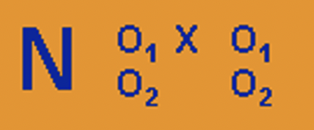
Quasi-Experimental Design
on the pilot data
Time Series & Nonequivalent dependent variables
Observations:
Post content
post text
post length
Engagement
number of comments
upvoted ratio
user ID
X (treatment): COVID

Slide 19
Quasi-Experimental Design
on the pilot data
Time Series & Nonequivalent dependent variable
Depression Subreddit - Time Series
Num of comments pre- covid | Upvote ratio pre covid | Unique id pre covid | Post text length pre covid | Post text topic modeling pre covid | x COVID | Num of comments post covid | Upvote ratio post covid | Unique id post covid | Post text length post covid | Post text topic modeling post covid
Replicate this experimental design to other 8 mental health related subreddits - Nonequivalent dependent variables

Slide 20
Thank You.
Any questions?

